Slide 1
SSL/TLS Certificate Measurement Analysis Report

Slide 2
Experimental Procedures
Experimental Results
01
02
CONTENTS
Experimental Conclusions
Recommendations
03
04

Slide 3
Experimental Procedures
01

Slide 4


Data Collection and Processing
Nmap Active Scanning
External Data Integration
Nmap actively scanned port 443 for SSL certificates, extracting 1167 records covering thousands of subjects.
External data was sampled at a 0.3 ratio and merged, forming a balanced set of 1383 records and a complete set of 4366 records.

Slide 5




Certificate Attribute Analysis
Certificate Reuse Analysis
In-depth analysis of key attributes including Issuer, Signature Algorithm, Public Key Type, and Public Key Bits, focusing on certificate validity period and expiration status to comprehensively assess certificate health.
Statistical analysis of certificate reuse across different IPs based on certificate fingerprints.
Revocation Status Sampling
Reproducibility Instructions
Sampling query of 100 certificates using OCSP protocol to detect their revocation status.
Provided complete command-line toolchain and script line to ensure experiment reproducibility.

Slide 6
Experimental Results
02

Slide 7
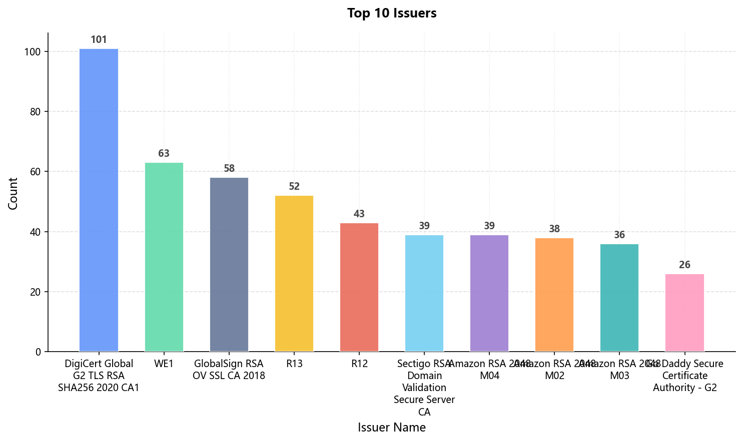
1. Certificate Issuer Distribution
Nmap Data
Major issuers include DigiCert, WE1, GlobalSign, Sectigo, Amazon, etc.

Slide 8
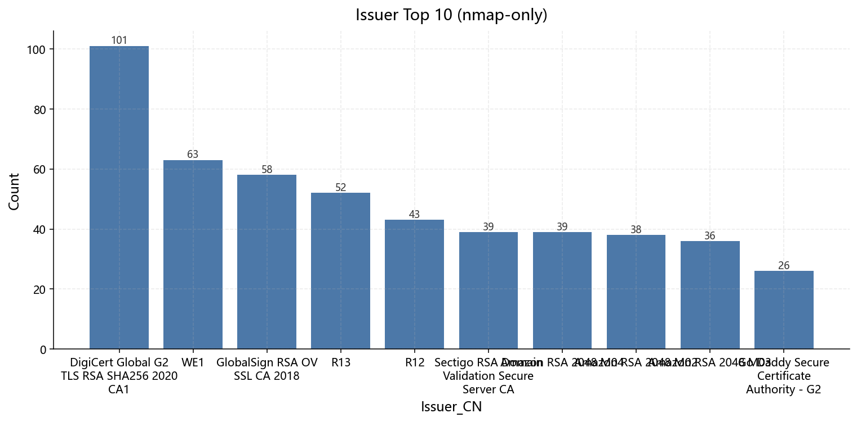
1. Certificate Issuer Distribution
Balanced Dataset
Most same with Nmap data, But adding traditional CAs like Thawte and DigiCert.

Slide 9
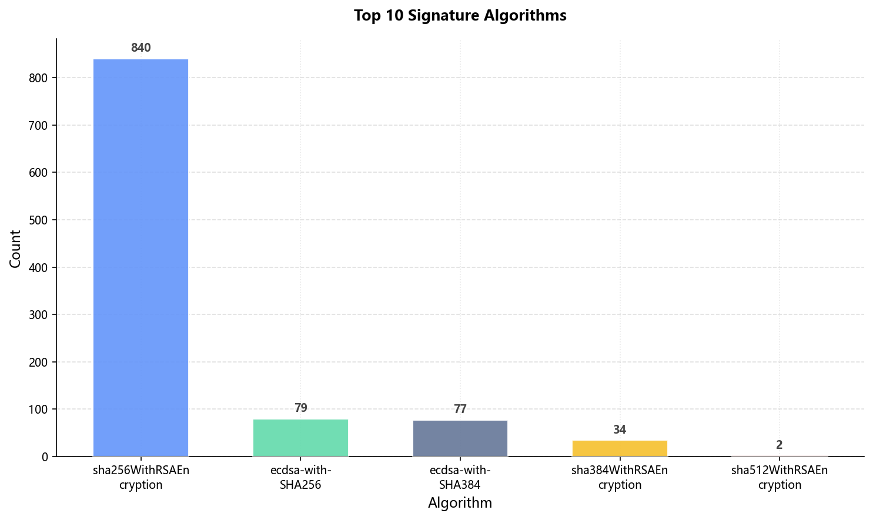
2. Signature Algorithms
Mainstream Algorithms
SHA-256 and RSA encryption dominate the mainstream algorithms.
ECC Algorithms
ECDSA algorithmare present in smaller proportions, significantly lower than RSA.

Slide 10
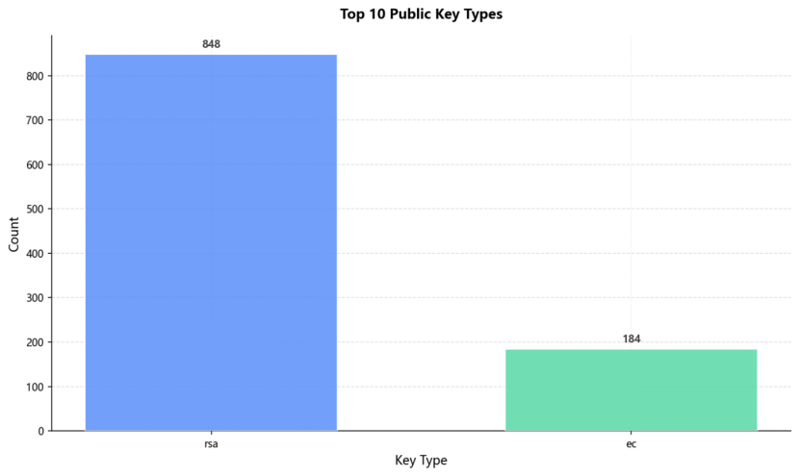
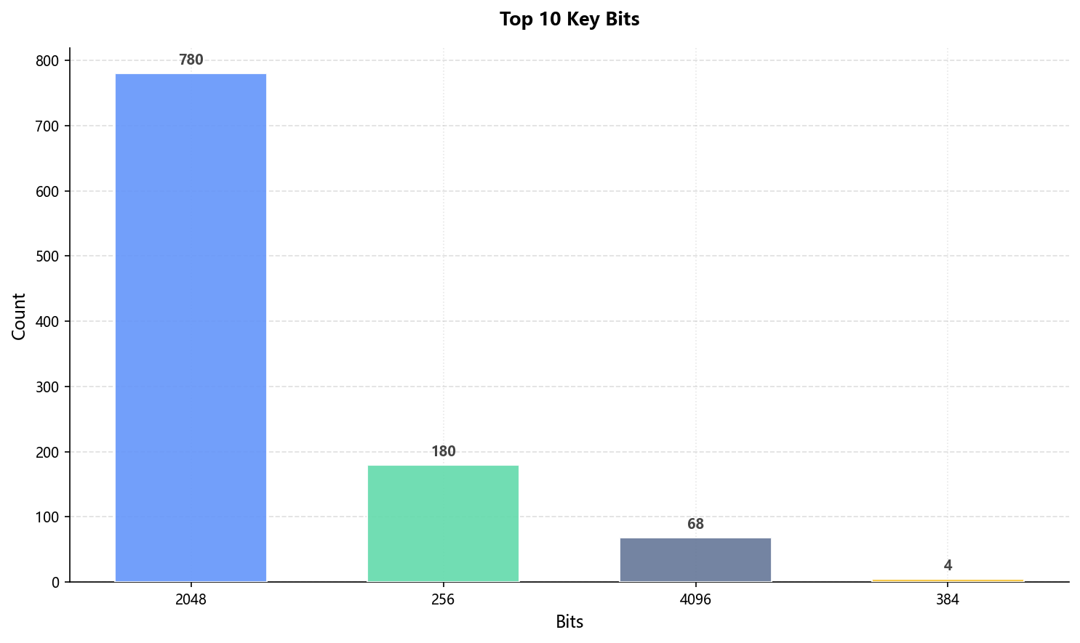
3. Public Key
Key Types
Key Lengths
RSA accounts for the majority (Nmap: 932/1167, Balanced: 848/1383), followed by ECC.
RSA 2048 bits is most common, followed by ECC 256 bits.

Slide 11



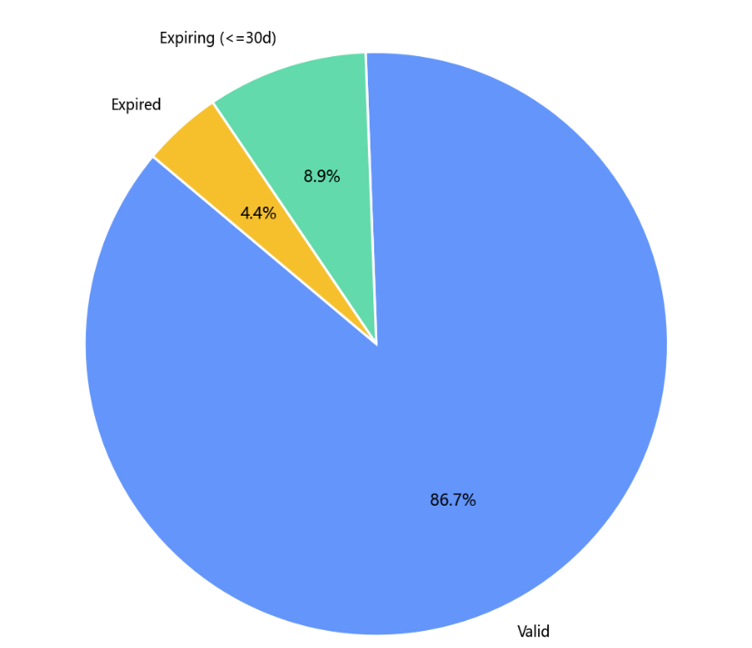
4. Certificate Validity Period
Expiring Soon (≤30 days) have 101 (8.9%).
Expired Certificates 50 in balanced dataset (4.4%).
Most certificates are in valid status (86.7%).

Slide 12
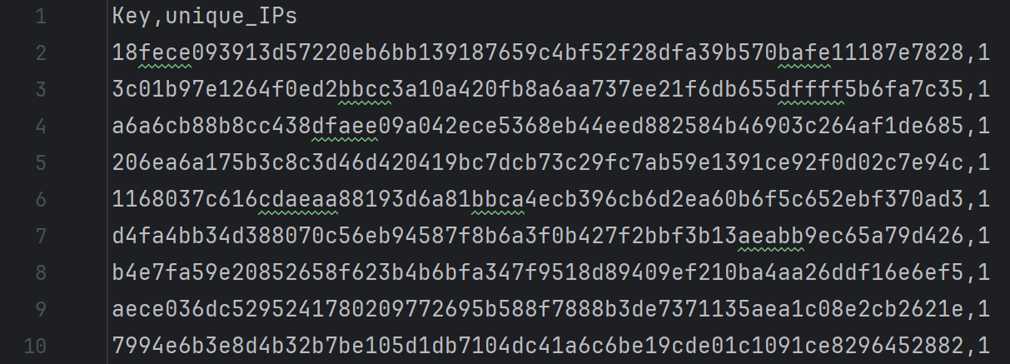
5. Certificate Reuse
In the data collected so far, no instances of certificate reuse have been found, and all certificate fingerprints have aappeared only once.

Slide 13
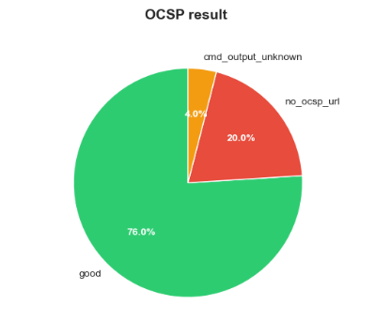
6. Revocation Status Sampling
The vast majority (76%) were valid, one-fifth (20%) had no connection access.
very few had command errors (4%), and none (0%) had been revoked.

Slide 14
Experimental Conclusions
03

Slide 15
1. Good Security Isolation
Certificate reuse across different services is extremely rare; the top 50 most common certificate fingerprints all appear on only one IP address. This indicates that most services use independent certificates, which is beneficial for security isolation and key management. It also reduces the risk of "one certificate being compromised, affecting the entire network."

Slide 16



2. Certificate Expiration Issues
Cloud Service Providers
Social Media
Enterprise Networks

Slide 17
3. OCSP Revocation Checking
Nearly a quarter of certificates cannot have their revocation status effectively verified via OCSP.
OCSP's reliability as a revocation verification mechanism is insufficient in practical deployments, affecting the effectiveness of certificate revocation mechanisms.

Slide 18
4. Trends in Algorithm and Key Deployment
RSA-2048+SHA256 remains the dominant approach. ECC usage is concentrated in 256-bit systems and is mostly used in emerging or large-scale internet services (such as Facebook and WhatsApp). 4096-bit RSA has a certain proportion and is more commonly found in enterprise-level or high-security scenarios.

Slide 19



5. Data Source for Different Perspectives
Nmap Data
External Data (CT Logs)
Balanced Dataset
Reflects current actual deployment status, providing a realistic picture of network conditions.
Contains more historical certificates and traditional CA issuance records.
Avoids statistical bias from CT data, more truly reflecting current network conditions. Recommendations

Slide 20
Recommendations
04

Slide 21


01
02
Certificate Lifecycle Management
Revocation Check Mechanisms
Establish automated monitoring & renewal workflows to avoid service outages from expirations
Implement centralized certificate inventory management
Enforce policies for short-lived certificates (e.g., Let’s Encrypt)
Supplement OCSP with CRL, certificate pinning, or modern solutions (CRLite/CRLSet) for reliability
Adopt short-lived certificates in high-security environments to reduce revocation dependency
Regularly audit the effectiveness of selected revocation methods

Slide 22
03
04
05
Algorithm Migration
Prioritize ECC (approved curves: P-256, P-384) for new deployments (better performance, stronger per-bit security)
Proactively plan migration of existing RSA-based services (consider compatibility needs)
Monitor and prepare for post-quantum cryptography as standards mature
Enhanced Measurement & Monitoring
Continuously monitor Certificate Transparency logs for domain-related misissued certificates
Use tools to track adoption trends of new encryption standards and potential vulnerabilities
Security Measures
Maintain low certificate reuse rates (best practice)
Enhance private key protection (e.g., HSM for critical systems)
Conduct regular security audits focusing on certificate/key usage

Slide 23
Thank You
THE END

